Slide 1

SQL & ERD - PHW#1
Benjamin Zhong

Slide 2
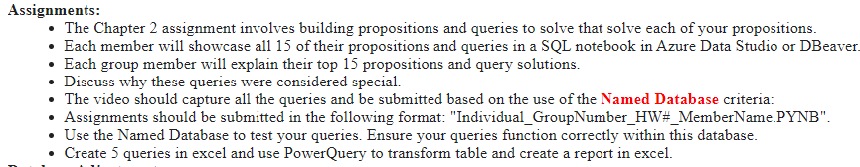
Project Overview

Slide 3
Project Plan & Strategy
Begin (9/7)
Finish Chapter 2 Review and Exercises
Finish Chapter 3 Review and Exercises
Create and utilize Project Planning Documents / Task management Documents
Create movie (mp4)
Final Submission

Slide 4
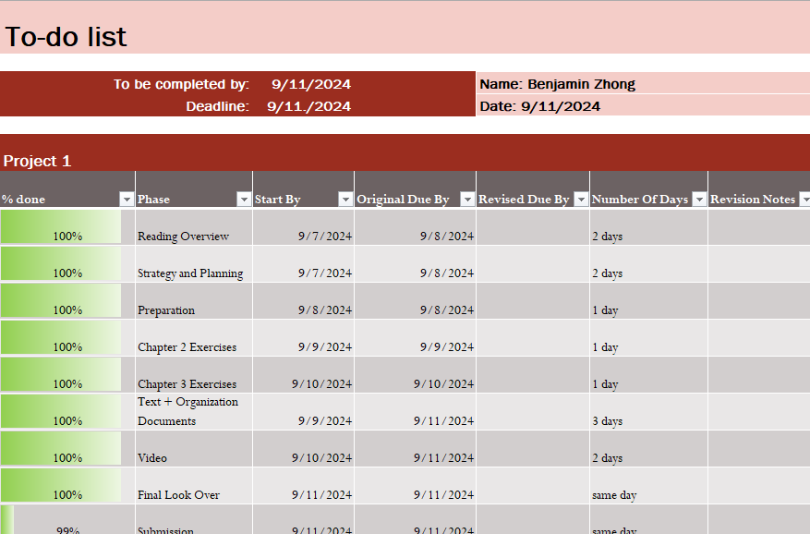
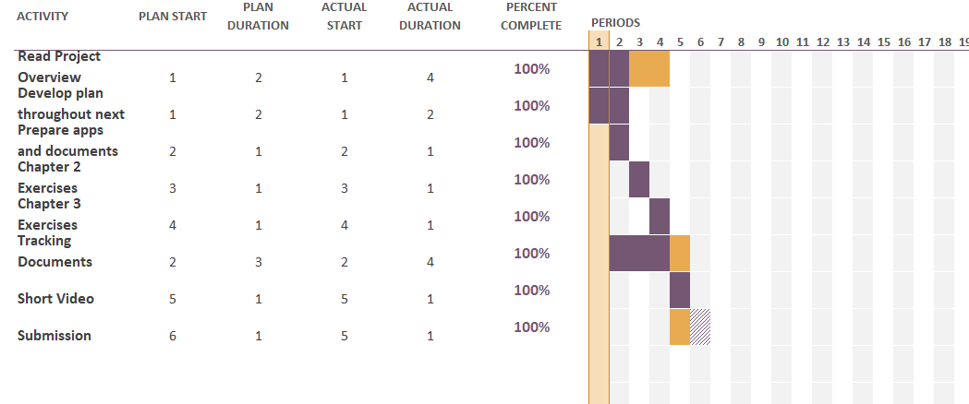
Task and Planning Documents
Gannt Chart
To Do Lists

Slide 5





Technology Aids
Microsoft 365
Azure Data Studios along side SSMS
Docker Containers
WSL
SQL Server
ChatGPT and Google Gemmini-2
Discord (Communication)

Slide 6
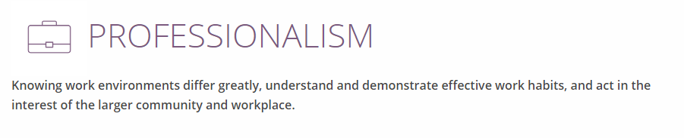
Nace - Professionalism through Collaboration

Slide 7

Collaborations
Having a Discord call allows for real-time communication, helping everyone clarify any confusion about the database class quickly. It ensures that all team members can ask questions and receive instant feedback, aligning understanding and expectations. Additionally, the informal setting can foster collaboration and idea sharing more effectively than text-based discussions.

Slide 8
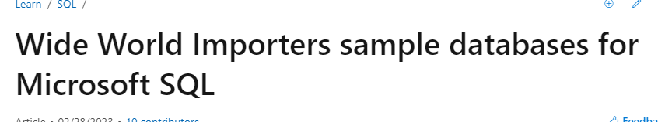
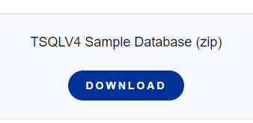

Chapter 2 Exercises
Databases Involved
WideWorldImporters (Microsoft)
TSQLV4 (Itzik Ben-gan)

Slide 9
Chapter 3 Exercises
Tables Involved
TSQLV4 (Itzik Ben-gan)

Slide 10
Final Thoughts

